Slide 1
Pre WWI and Reactions to the Balfour Declaration

Slide 2
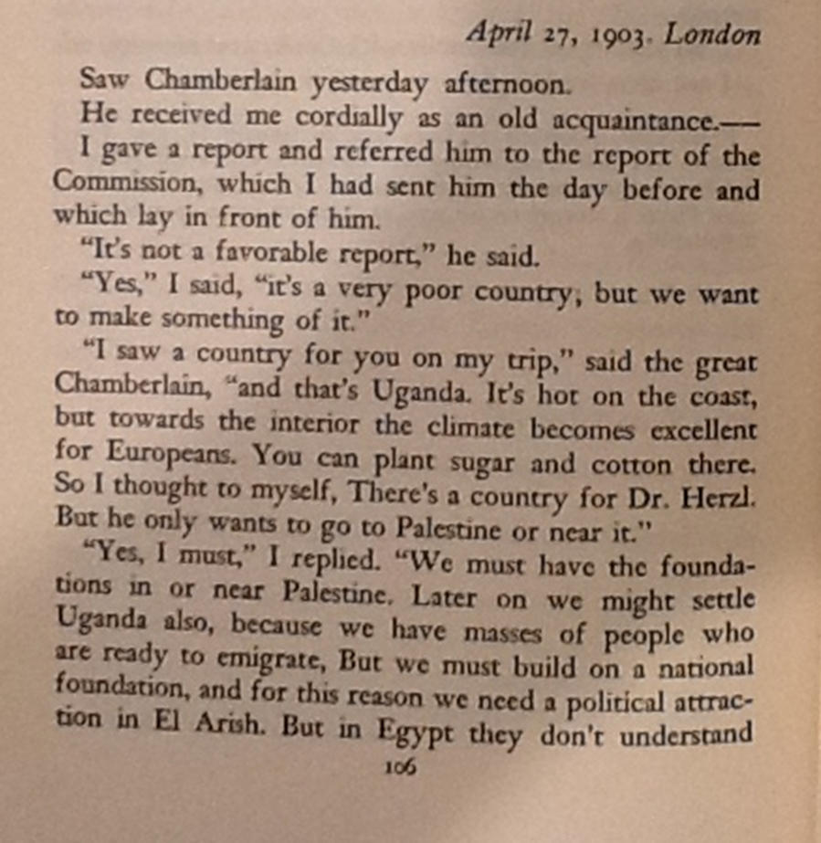
Herzl’s Diary
Oct 23, 1902
Talked yesterday with the famous master-figure of England, Joe Chamberlain. One hour. I explained to him all of my intentions, and he listened carefully. Unfortunately, my voice quivered a little at first, which, as I spoke, more than a little annoyed me. After a few minutes, however, things improved and I talked with quiet vigor, so far as my helter-skelter English permitted.
Addressing myself to Joe Chamberlain's imperturbable mask, I presented the entire Jewish Question as I understood it, and desired to solve it. My negotiations with Turkey (for Palestine), etc….
He was willing, however, to help if he could: he liked the Zionist idea. If I could show him a spot among the British possessions which was not yet inhabited by white settlers, then we could talk.
Video 8:30

Slide 3
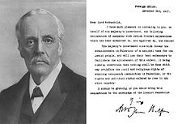
The Balfour Declaration
2 November 1917
His Majesty's government view with favour the establishment in Palestine of a national home for the Jewish people, and will use their best endeavours to facilitate the achievement of this object, it being clearly understood that nothing shall be done which may prejudice the civil and religious rights of existing non-Jewish communities in Palestine, or the rights and political status enjoyed by Jews in any other country.

Slide 4
C.E. Vickery on Promises made to Sharif Hussein of Mecca
“This was done and unlocked by Hussein himself; he fumbled through some papers and finally threw one at me. “Read for yourself. O light of my eye.” he said. I read the letter very slowly…and it was quite evident that Palestine was not included in the proposals to the King.
I can say most definitely that the whole of the King’s demands were centered round Syria and only round Syria….
C.E. Vickery, (letter to the Times of London)
February 21, 1939

Slide 6
President Wilson’s reaction to the Balfour Declaration

Slide 7
Italian Ambassador’s reaction to the Declaration

Slide 8
Feisal/Weizmann Agreement 39:00
Agreement Between Emir Feisal and Dr. Weizmann^{[16]}
3 January 1919
His Royal Highness the Emir Feisal, representing and acting on behalf of the Arab Kingdom of Hedjaz, and Dr. Chaim Weizmann, representing and acting on behalf of the Zionist Organization, mindful of the racial kinship and ancient bonds existing between the Arabs and the Jewish people, and realizing that the surest means of working out the consummation of their natural aspirations is through the closest possible collaboration in the development of the Arab State and Palestine, and being desirous further of confirming the good understanding which exists between them, have agreed upon the following:
Articles: Article I
The Arab State and Palestine in all their relations and undertakings shall be controlled by the most cordial goodwill and understanding, and to this end Arab and Jewish duly accredited agents shall be established and maintained in the respective territories.
Article II
Immediately following the completion of the deliberations of the Peace Conference, the definite boundaries between the Arab State and Palestine shall be determined by a Commission to be agreed upon by the parties hereto.

Slide 9
Article III
In the establishment of the Constitution and Administration of Palestine, all such measures shall be adopted as will afford the fullest guarantees for carrying into effect the British Government's Declaration of the 2nd of November, 1917.
Article IV
All necessary measures shall be taken to encourage and stimulate immigration of Jews into Palestine on a large scale, and as quickly as possible to settle Jewish immigrants upon the land through closer settlement and intensive cultivation of the soil. In taking such measures the Arab peasant and tenant farmers shall be protected in their rights and shall be assisted in forwarding their economic development….
Chaim Weizmann Feisal Ibn-Hussein
Reservation by the Emir Feisal
If the Arabs are established as I have asked in my manifesto of 4 January, addressed to the British Secretary of State for Foreign Affairs, I will carry out what is written in this agreement. If changes are made, I cannot be answerable for failing to carry out this agreement.

Slide 10
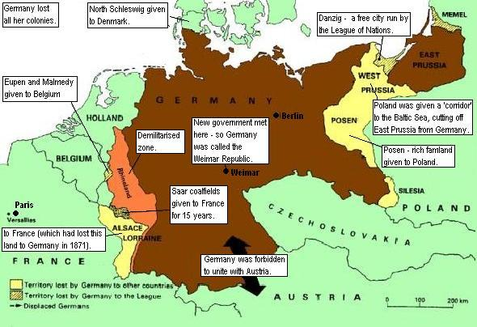
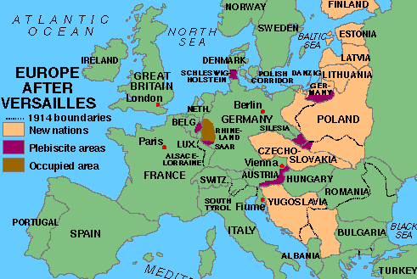
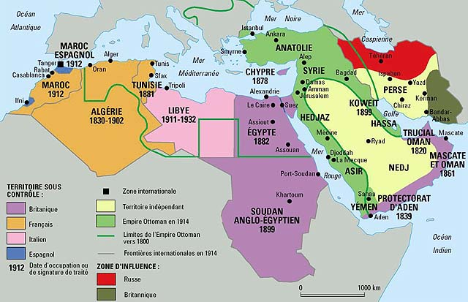
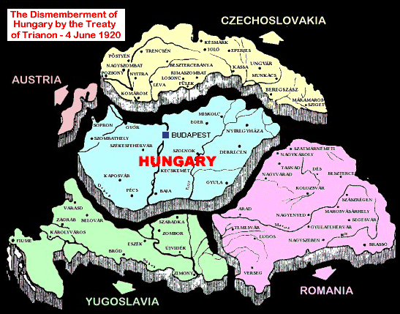
Ottoman Empire
1914
Notes:
As a result of the sessions of the Paris Peace Conference in 1919 and 1920 which culminated in the Treaties of Versailles, Saint-Germain, Neuilly, and Trianon the map of Europe was forever changed.

Slide 11
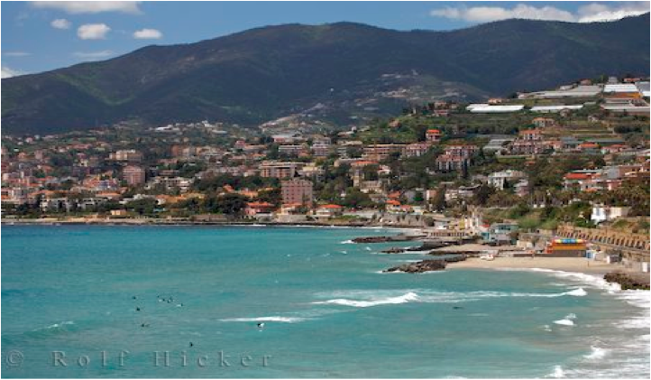
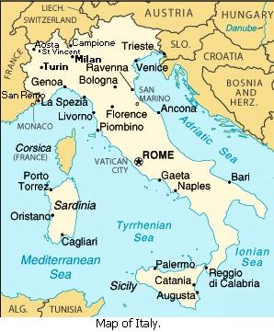
San Remo

Slide 12
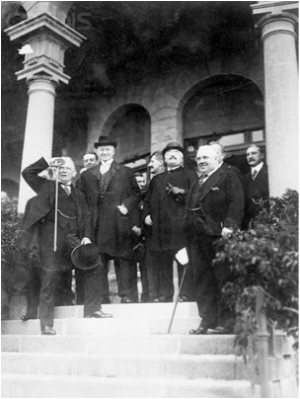
Delegates of the San Remo Conference
Curzon
Nitti
Lloyd George
Berthelot
Millerand
Notes:
The delegates in the picture are (from left to right): David Lloyd George - Britain, Lord Curzon - Britain, Alexandre Millerand - France, Francesco Nitti - Italy

Slide 14
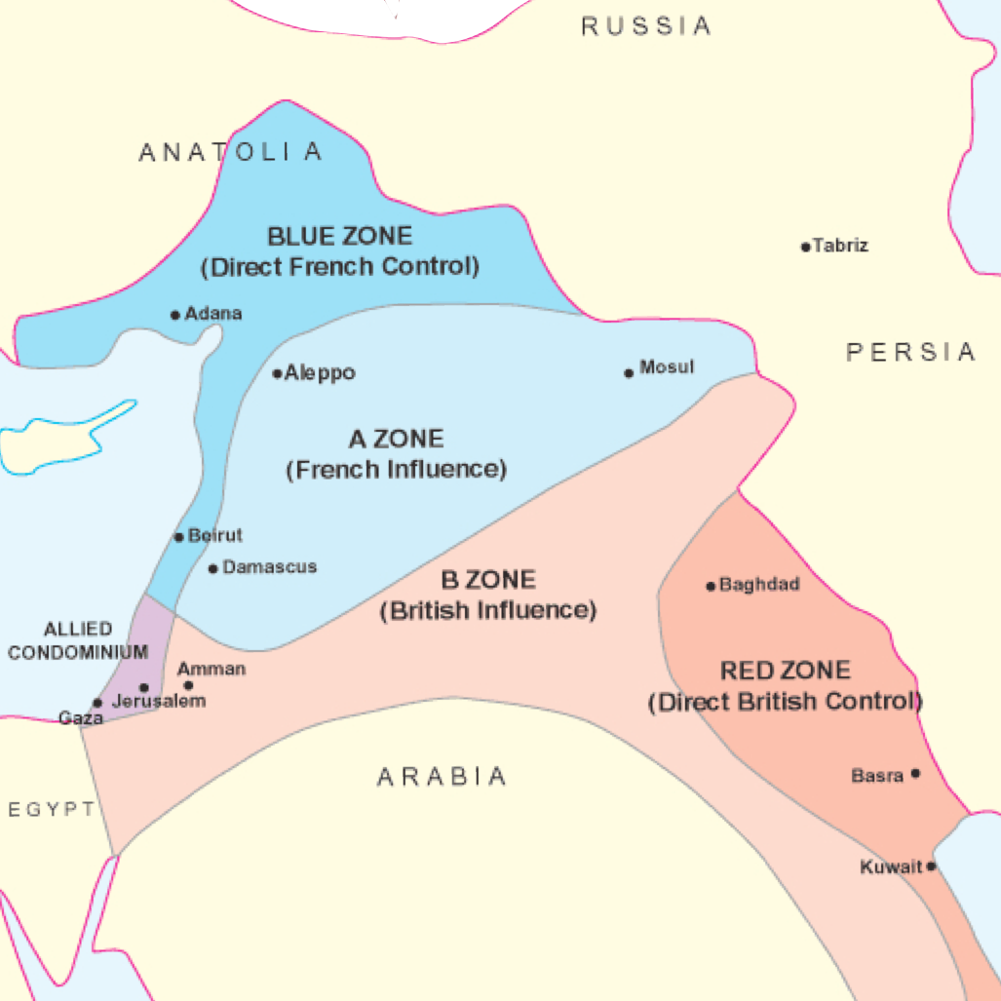
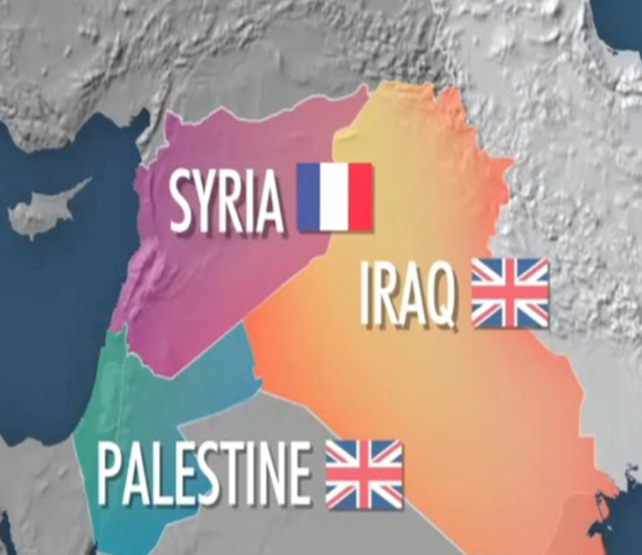
Sykes-Picot Agreement

Slide 15
Preamble
The Council of the League of Nations: Whereas the Principal Allied Powers have agreed, for the purpose of giving effect to the provisions of Article 22 of the Covenant of the League of Nations, to entrust to a Mandatory selected by the said Powers the administration of the territory of Palestine, which formerly belonged to the Turkish Empire, within such boundaries as may be fixed by them; and | Basis for Mandate system in the remain of the Ottoman Territory Self –Determination/Majority

Slide 16
Preamble
Whereas the Principal Allied Powers have also agreed that the Mandatory should be responsible for putting into effect the declaration originally made on November 2nd, 1917, by the Government of His Britannic Majesty, and adopted by the said Powers, in favor of the establishment in Palestine of a national home for the Jewish people, it being clearly understood that nothing should be done which might prejudice the civil and religious rights of existing non-Jewish communities in Palestine, or the rights and political status enjoyed by Jews in any other country; and | 1. However, based on the B.D.

Slide 17
Preamble
Whereas recognition has thereby been given to the historical connection of the Jewish people with Palestine and to the grounds for reconstituting their national home in that country; and Whereas the Principal Allied Powers have selected His Britannic Majesty as the Mandatory for Palestine; and Whereas the mandate in respect of Palestine has been formulated in the following terms and submitted to the Council of the League for approval; and | Historical connection Britain in charge Approved by the League of Nations.

